Slide 1
Flight Fare prediction
Anwesha Das

Slide 2
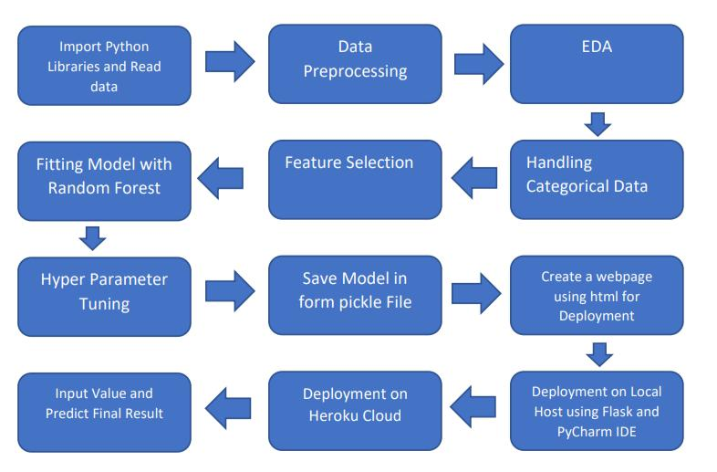
Architecture

Slide 3
Q & A
Q1) What’s the source of data?
The data for training is provided by the client in multiple batches
Q 2) What was the type of data?
The data was the combination of numerical and Categorical values.
Q 3) What’s the complete flow you followed in this Project?
Refer Page no 5 in LLD for better Understanding.

Slide 4
Q&A
Q 4) What techniques were you using for data pre-processing?
Removing unwanted attributes.
Visualizing relation of independent variables with each other and output variables.
Checking and changing Distribution of continuous values .
Cleaning data and imputing if null values are present.
Converting categorical data into numeric values.

Slide 5
Q 7) How training was done or what models were used?
Before dividing the data in training and validation set, we performed pre-processing over the data set and made the final dataset.
As per the dataset training and validation data were divided
Algorithms like Random Forest, XGBoost were used based on the recall, final model was used on the dataset and we saved that model.

Slide 6
Q 8) How Prediction was done?
The testing files are shared by the client. We Performed the same life cycle on the provided dataset. Then, on the basis of dataset, model is loaded and prediction is performed. In the end we get the accumulated data of predictions.

Slide 7
Q 9) What are the different stages of deployment?
First, the scripts are stored on GitHub as a storage interface.
The model is first tested in the local environment.
After successful testing, it is deployed on any cloud platform.

